Slide 1

Predictive Modelling in-hospital mortality following with elective surgery
by
Ragamai kottapalli & Divya Guntupalli

Slide 2
Abstract
To improve patient outcomes, allocate resources as effectively as possible, and reduce preventable deaths, it is crucial to forecast in-hospital mortality after elective surgery. Using preoperative, intraoperative, and postoperative data, this study aims to develop a predictive model that assesses patient risk using machine learning methods. A dataset that includes hospital performance evaluations and patient records is used to evaluate how well various predictive algorithms identify high-risk patients. The study compares a number of machine learning algorithms and highlights the models that perform the best in terms of mortality prediction. The results can be used to inform clinical decisions and enhance postoperative care practices. Using a dataset of patient records and hospital performance ratings, we apply a variety of machine learning models, including Random Forest, Logistic Regression, Support Vector Machine (SVM), Decision Tree, Neural Networks, and gradient boosting machines. These models are compared based on their predicted accuracy, interpretability, and ability to handle unbalanced data. The findings help physicians identify high-risk patients early and improve postoperative outcomes.

Slide 3
Problem Statement
In-hospital mortality after elective surgery remains a serious concern despite advancements in medical practices and surgical techniques. Early detection of a patient's increased risk of death can lead to better patient survival rates, fewer complications, and timely therapies. However, traditional methods of evaluating risk are often imprecise and fail to recognize complex relationships in patient information. This study intends to develop and evaluate machine learning models that can accurately predict in-hospital mortality using significant clinical and demographic data.

Slide 4
DATASET OVERVIEW
The dataset used in this project is the California inpatient mortality rates and quality ratings. It contains information about various hospitals across California, including mortality rates, number of deaths and cases, procedures/conditions that were treated, and the overall hospital quality ratings

Slide 5
Literature Review & Introduction
Clinical outcomes, operational efficiency, and patient satisfaction are all included in hospital performance ratings, which are essential indicators of the standard of medical care. Previous studies highlight the role that performance metrics play in guiding healthcare policy, improving patient care, and enabling hospital comparisons. Research shows that ratings' transparency can increase accountability, despite persistent problems with inconsistent methodology and data reliability.
This study looks at hospital performance ratings in California to assess key quality indicators and find trends that impact patient outcomes. By using the data currently available, it aims to identify the region's strengths, weaknesses, and opportunities for improving healthcare delivery.

Slide 6
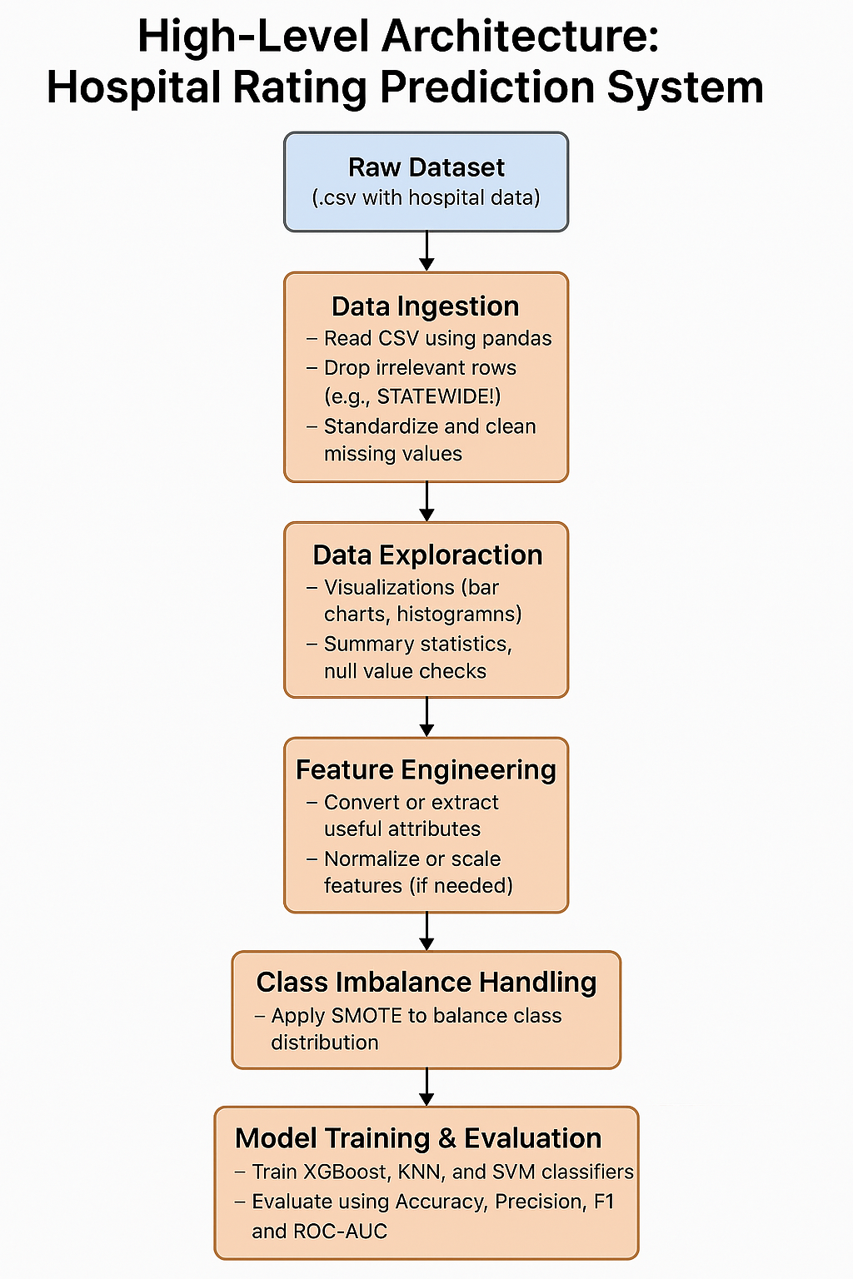
High Level Architecture

Slide 7
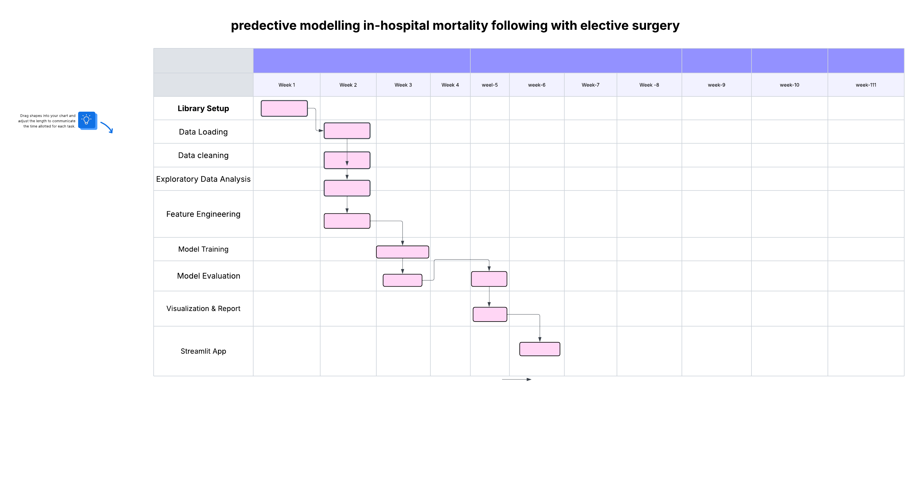
GNATT CHART TIMELINE

Slide 8
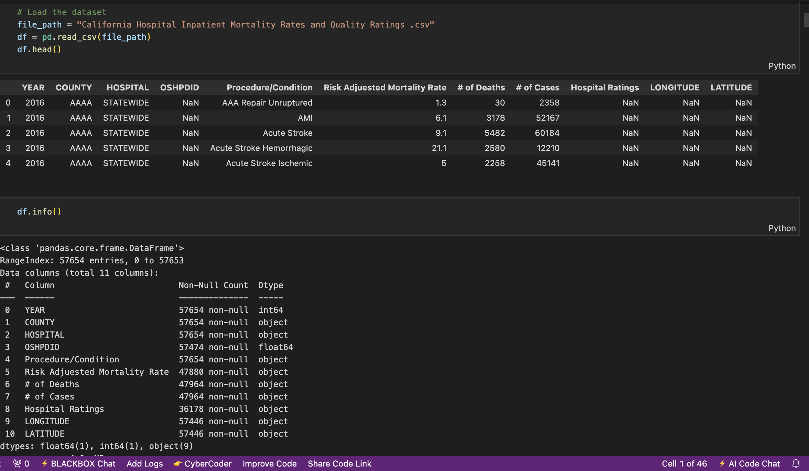
Exploratory Data Analysis[EDA]
Started by loading the dataset and checking for any missing values using .info()
Used .describe() to explore basic stats and spot any inconsistencies or unusual values
Analyzed how hospital mortality ratings were distributed
Found that most hospitals were rated "As Expected"
Created bar charts and histograms to visualize mortality trends and detect any skewness or outliers
Noticed a class imbalance in the target variable, which could impact model accuracy

Slide 9
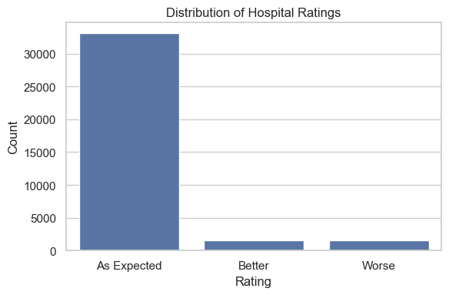
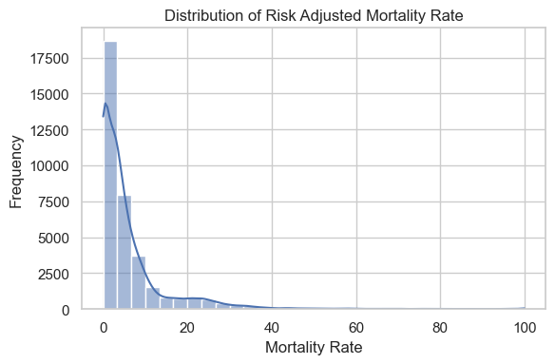
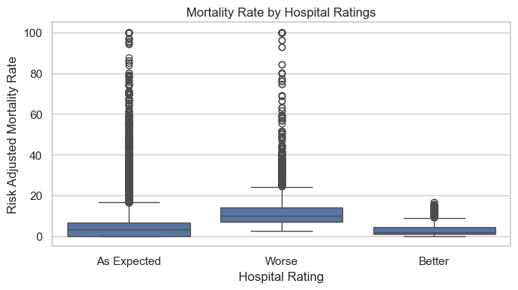
Visual Insights from EDA

Slide 10
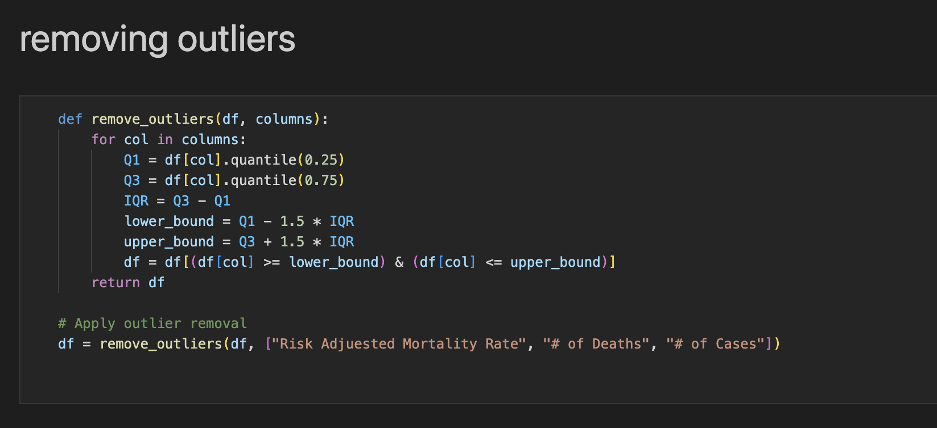
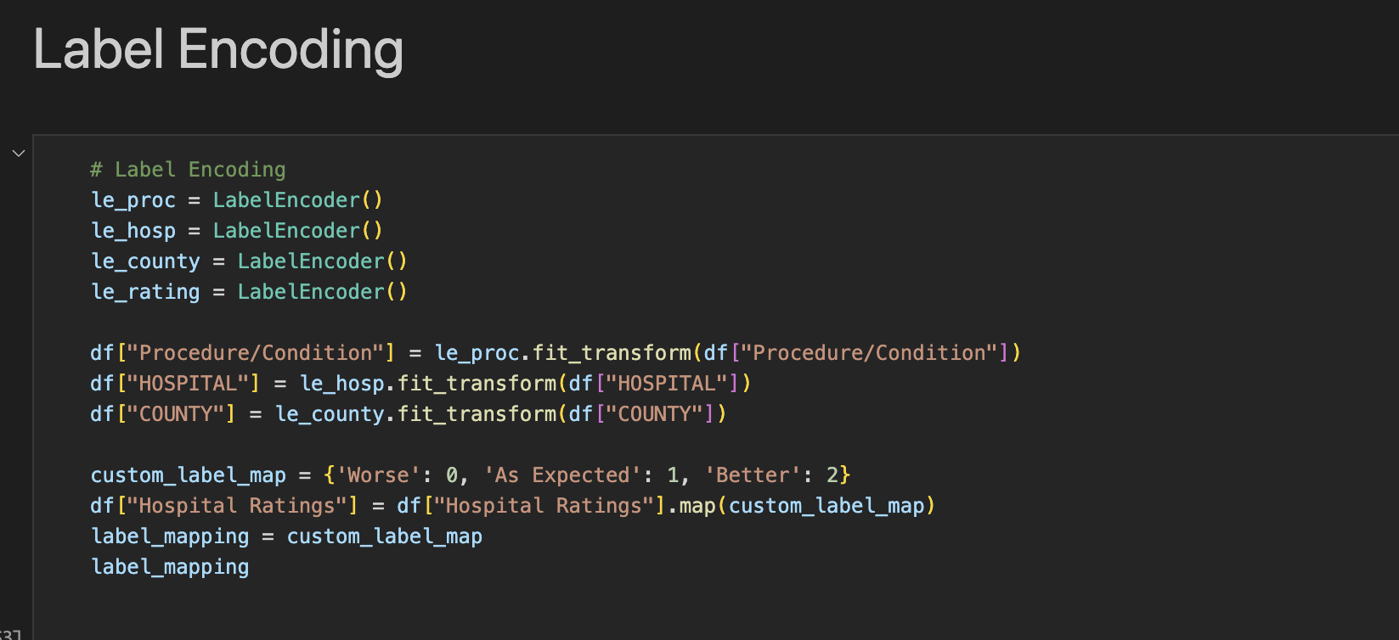
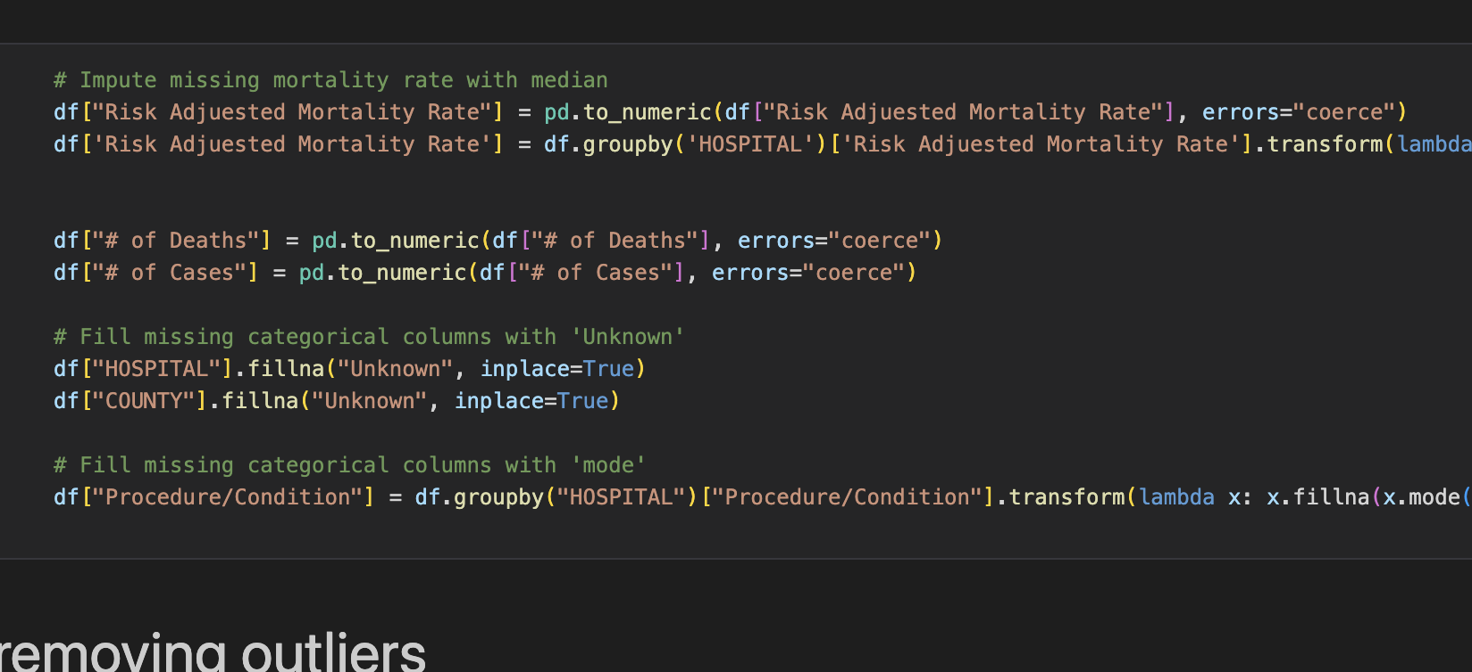
DATA PREPROCESSING
We encoded categorical variables using LabelEncoder to make them machine-readable.
Converted numerical columns stored as strings into proper float types for analysis.
Handled outliers by applying IQR filtering, which helped clean up extreme values that could skew the model.
Filled missing values using the median for numerical columns.

Slide 11
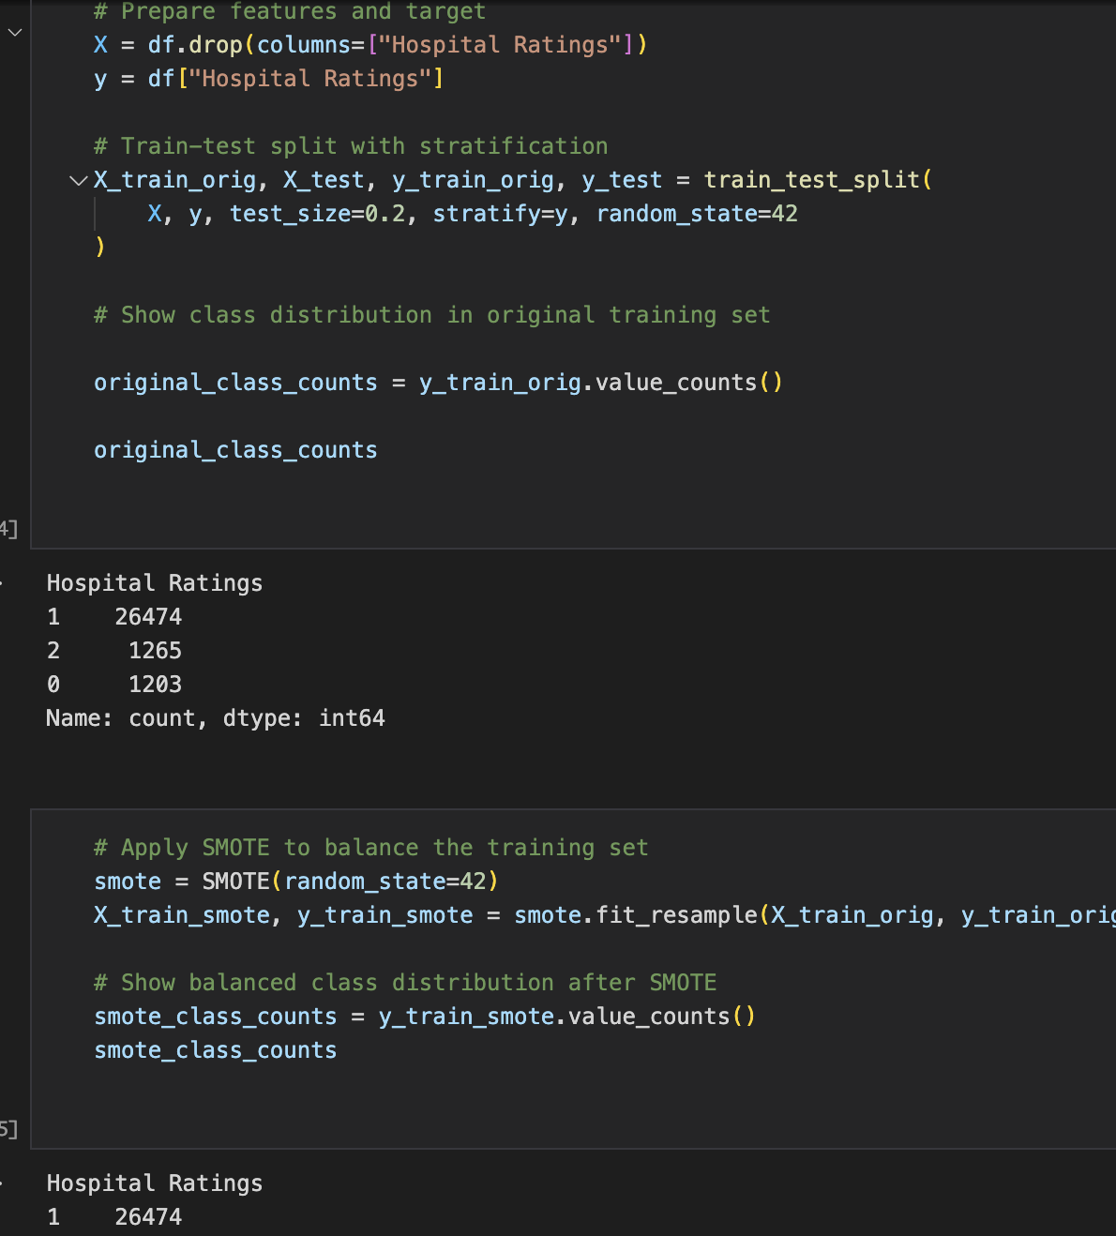
Handling Imbalanced Data
First, we separated the features and the target Hospital Ratings
Then, we performed a stratified train-test split to maintain the original class proportions in both sets.
We examined the class distribution in the training set to confirm the imbalance before applying any resampling.
we applied SMOTE to balance the class distribution
After applying SMOTE, the class distribution became more balanced, which led to improved performance across all classes during model training and evaluation.

Slide 12
Models Implemented
Random Forest Classifier
XGBoost Classifier
K-Nearest Neighbors (KNN)
Support Vector Classifier (SVM)

Slide 13
Random forest
We trained the model on both the original and SMOTE-balanced datasets to tackle the class imbalance issue in hospital ratings.
This model served as a strong baseline because of its robustness and ability to work well with mixed types of data both numerical and categorical.
To understand how well the model actually performed, we looked at a few important metrics:
✅ Accuracy: (0riginal data)98.65%
🎯 Precision(original data):98.67%
📊 F1 Score(original data): 94.08%
🚀 ROC AUC: 99.47%
These results clearly showed that using SMOTE for class balancing improved the model's ability to identify minority classes more effectively.
Accuracy(smote data):0.981758
precision(smote data):0.924835
F1 Score (smote data):0.935917

Slide 14
XGBOOST CLASSIFIER
We trained the model on both the original and SMOTE-balanced datasets to tackle the class imbalance issue in hospital ratings.
XGBoost is a smart and fast machine learning model that's especially good at making accurate predictions with spreadsheet-like (tabular) data.
To understand how well the model actually performed, we looked at a few important metrics:
✅ Accuracy(original data): 0.990603
Accuracy (smote data): 0.960199
Precession(original data): 0.974196
Precission (smote data): 0.801006
F1 Score(original data):0.960987
F1 Score (smote data ): 0.857564
Roc –AUC Curve: 0.998762
These results clearly showed that using SMOTE for class balancing improved the model's ability to identify minority classes more effectively

Slide 15
K-NEAREST NEIGHBOUR
We trained the model on both the original and SMOTE-balanced datasets to tackle the class imbalance issue in hospital ratings.
KNN is a simple, intuitive algorithm that classifies data based on how close it is to other points in the training set.
To understand how well the model actually performed, we looked at a few important metrics:
✅ Accuracy(original data):0.939866
Accuracy (smote data): 0.868083
Precession(original data): 0.617511
Precission (smote data): 0.516060
F1 Score(original data): 0.450745
F1 Score (smote data ): 0.585802
Roc –AUC Curve: 0.865517
These results suggest that SMOTE helped improve KNN’s ability to detect minority classes, though overall accuracy dropped slightly.

Slide 16
SUPPORT VECTOR MACHINE
We trained the model on both the original and SMOTE-balanced datasets to tackle the class imbalance issue in hospital ratings.
SVM tries to find the best boundary between classes using a mathematical function called a hyperplane.
To understand how well the model actually performed, we looked at a few important metrics:
✅ Accuracy(original data): 0.940038
Accuracy (smote data): 0.617612
Precession(original data): 0.313346
Precission (smote data): 0.801006
F1 Score(original data):0.960987
F1 Score (smote data ): 0.857564
Roc –AUC Curve: 0.865517
Its performance was poor on imbalanced data, but SMOTE slightly improved class detection.

Slide 17
conclusion
This proposed machine learning framework can be useful in predicting in-hospital mortality ,as we can identify the number of death cases ,high mortality rates and the hospital ratings associated with it which helps improve clinical-decision making and strategies to identify the patients who might be at risk. According to this data we can identify the hospitals with highest and lowest mortality rates

Slide 18
References
Dr D. Nepogodiev, National Institute for Health Research Global Health Research Unit on Global Surgery, Heritage Building, University of Birmingham, Mindelsohn Way, Birmingham B15 2TH, UK
Sun, Y., Heng, B. H., Tay, S. Y., & Seow, E. (2011). Predicting hospital admissions at emergency department triage using routine administrative data. Academic Emergency Medicine, 18(8), 844–850.
Sherwood, M. W., Brennan, J. M., Ho, K. K. L., Masoudi, F. A., Messenger, J. C., Weaver, W. D., Dai, D., & Peterson, E. D. (2015). The impact of extreme-risk cases on hospitals' risk-adjusted percutaneous coronary intervention mortality ratings. JACC: Cardiovascular Interventions, 8(1), 10–16. https://www.jacc.org/doi/abs/10.1016/j.jcin.2014.07.025
Rajkomar, A., Oren, E., Chen, K., Dai, A. M., Hajaj, N., Hardt, M., Liu, P. J., Liu, X., Marcus, J., Sun, M., Sundberg, P., Yee, H., Zhang, K., Zhang, Y., Flores, G., Duggan, G. E., Irvine, J., Le, Q., Litsch, K., Mossin, A., Tansuwan, J., Wang, D., Wexler, J., Wilson, J., Ludwig, D., Volchenboum, S. L., Chou, K., Pearson, M., Madabushi, S., Shah, N. H., Butte, A. J., Howell, M. D., Cui, C., Corrado, G. S., & Dean, J. (2018). Scalable and accurate deep learning with electronic health records. npj Digital Medicine, 1(1), 18. https://www.nature.com/articles/s41746-018-0029-1
Zheng, D., Ni, C.-C., Wang, M., Song, X., Gan, Q., Karypis, G., & Zhang, Z. (2021). Deep learning with heterogeneous graph embeddings. Transactions on Machine Learning and Artificial Intelligence, 3(3), 329–351. https://doi.org/10.1162/dint_a_00094
Brown, T., Mann, B., Ryder, N., Subbiah, M., Kaplan, J., Dhariwal, P., ... & Amodei, D. (2020). Language models are few-shot learners. https://arxiv.org/abs/2009.01366
Wong, D. J. N., Harris, S., Sahni, A., Bedford, J. R., Cortes, L., Shawyer, R., Wilson, A. M., Lindsay, H. A., Campbell, D., Popham, S., Moonesinghe, S. R. (2020). Developing and validating subjective and objective risk-assessment measures for predicting mortality after major surgery: An international prospective cohort study. PLOS Medicine, 17(10), e1003253. https://doi.org/10.1371/journal.pmed.1003253
Resnic, F. S., & Welt, F. G. P. (2009). The public health hazards of risk avoidance associated with public reporting of risk-adjusted outcomes in coronary intervention. Journal of the American College of Cardiology, 53(10), 825-830. https://doi.org/10.1016/j.jacc.2008.11.034

Slide 19
Wong DJN, Harris S, Sahni A, et al. Developing and validating subjective and objective risk-assessment measures for predicting mortality after major surgery: An international prospective cohort study. PLoS Med. 2020;17(10):e1003253. https://journals.plos.org/plosmedicine/article?id=10.1371/journal.pmed.1003253
Du, X., Wang, H., Wang, S., He, Y., Zheng, J., Zhang, H., Hao, Z., Chen, Y., Xu, Z., & Lu, Z. (Year). Title of the article. Journal Name, Volume(Issue), Article number. https://doi.org/10.31083/j.rcm2311376
Rab, T., & Wilson, H. (2016). On behalf of the Interventional Council and Board of Governors. Division of Cardiology, Department of Medicine, Emory University, Atlanta, Georgia; Carolinas Medical Center, Charlotte, North Carolina. Journal Name (if applicable). Received November 29, 2015; accepted December 3, 2015; available online March 7, 2016. Version of record March 7, 2016. https://doi.org/10.1016/j.jcin.2015.12.006
Yan Sun 1, Bee Hoon Heng, Seow. Yian Tay, Eillyne Seow. Predicting hospital admissions at emergency department triage using routine administrative data. https://pubmed.ncbi.nlm.nih.gov/21843220/
Edward L. Hannan, PHD, MS, MSThe Public Reporting Risk of Performing High-Risk Procedures Perception or Reality? https://doi.org/10.1016/j.jcin.2014.08.005
Nallabasannagaari, A. R., Reddiboina, M., Seltzer, R., Zeffiro, T., Sharma, A., & Bhandari, M. (n.d.). All data inclusive, deep learning models to predict critical events in the Medical Information Mart for Intensive Care III Database (MIMIC III). https://arxiv.org/abs/2009.01366
Brennan, J. M., Curtis, J. P., Dai, D., Fitzgerald, S., Khandelwal, A. K., Spertus, J. A., Rao, S. V., Singh, M., Shaw, R. E., Ho, K. K. L., Krone, R. J., Weintraub, W. S., Weaver, W. D., & Peterson, E. D. (n.d.). Enhanced mortality risk prediction with a focus on high-risk percutaneous coronary intervention: Results from 1,208,137 procedures in the NCDR (National Cardiovascular Data Registry). https://doi.org/10.1016/j.jcin.2013.03.020

